Slide 1
Safety of information systems Testing and prototyping
Roman Danel
roman.danel@vsb.cz
VŠB – TU Ostrava

Slide 2
TESTING

Slide 3
Intel Pentium Error, 1994
(4195835 / 3145727 ) * 3145727 – 4195835
Software error on the chip – 30.10.1994, T. Nicely
Costs: replacement of sold chips - 400 mil. USD

Slide 4
Examples of Software Errors
Y2K – Year 2000
NFT in Decnet network
COBOL
Mars probe - two teams - one used English and the other used metric units
Lander on Mars (1999) – checking of the bit indicating eject landing legs
Missile defense system Patriot, 1991 – an error in the timing system clock

Slide 5
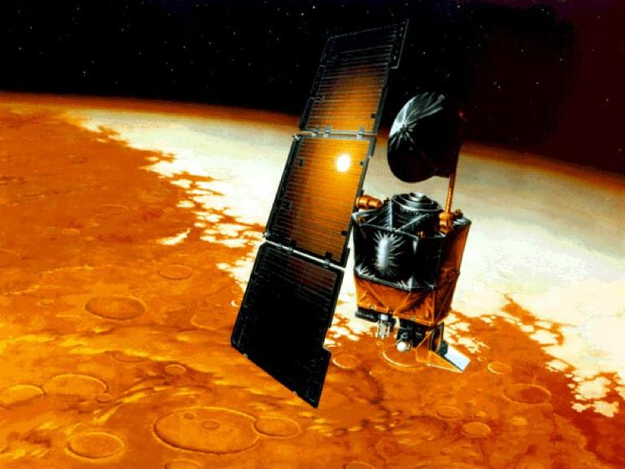
1999, the Mars Climate Orbiter was lost in space, at an estimated cost of $193 million. The problem stemmed from software developed by Lockheed Martin that converted a certain set of numbers into the wrong units.

Slide 6
„Pesticides Paradox“
Insects have time to get used pesticides and then stops to be controlled
The same software tested by the same people - stop finding fault, although there are still in SW

Slide 7
Error in specification (Analytical stage)
Contains quantifiers always, never, every, no, everybody ...
Trying to push somewhere - it is obvious, definitely, obviously ...
The list is not exhaustive - and so on, for example ...
Vague specifications - sometimes something, usually, usually mostly ...
Ambiguous quantifiers - good, cheap, small, stable
If - deciding specifications without else branch

Slide 8
Tests types
BLACK BOX – WHITE BOX
STATIC - DYNAMIC

Slide 9
DYNAMIC BLACK BOX TEST
Test-to-pass – are all functions included and working?
Test-to-fail

Slide 10
Grey Box
Translucent box
Limited knowledge of internal data structures and programming in order to propose suitable test scenarios, which are implemented at the black box.
E.g. tests interface

Slide 11
INPUT TESTING
Test boundary conditions
Sub-boundary test conditions - testing internal constraints
Test default, empty, blank and null values
Test for entering invalid or meaningless data

Slide 12
STATE TEST – APPLICATION LOGIC
Race Condition Test
Repetition Test
Stress test – the worst condition
Load Test – huge amount of users/access/transactions…

Slide 13
CONFIGURATION TEST
Test whether the software is running with all possible combinations HW
You can use the hardware specification published
Beta-testing

Slide 14
COMPATIBILITY TEST
Concurrence with other SW?
Backward compatibility?
Forward compatibility? (will be compatible with future versions…)

Slide 15
Unit test
Developer
Use appropriate algorithms, design patterns
Verification of the correctness of operation of the sub-code
Unit - separately testable part of an application
Stubs, mock object, fakes, …
Scrum, TDD

Slide 16
MULTILANGUAGE SUPPORT TEST
Localizing applications
Localizing data
UNICODE
Recommendation: texts should not come in code

Slide 17
Multilanguage support - formats
measurement units
numerical data
Currency (symbol and its location)
date display
Time Display (12/24)
calendar (Julian, Gregorian, Arabic ...)
address (eg. the shape zip code)
phone Numbers
size paper and envelope printing

Slide 18
USABILITY TEST
Standards in control
Consistency
Flexibility
Adherence to standards
Support for Disabled
Compliance with documentation

Slide 19
Other types of tests
Downgrade test – can you revert to previous version?
Test of installation
Long term test – how it behaves when the system running long time without interruption
Acceptance test
Performance test
Security test
Recovery test
Smoke test
Regression test

Slide 20
Automation
Monitor
A driver (e.g. script keyboard substitute)
Stub
An emulator (e.g. printers)
Macro Recorder
Tools for stress tests
Tools such as "silly monkey" - clicks
Tools such as "semi-intelligent ape" - recognizes the errors found
Tools like "intelligent ape" - he knows what he's doing

Slide 21
Alfa testing
Testing by real users
Unlike beta testing it is expected that the application still contains significant errors

Slide 22
Beta testing
The involvement of external parties to test - eg. The potential users
Advantage - can test even the hardware combinations that the author is not available
Disadvantage - do not systematically test all

Slide 23
Reasons for uncorrected errors
Not enough time
In fact, it‘s not a bug
The repair is too risky
Repair is not worth it

Slide 24
Certification - ISTQB
www.istqb.org
http://istqbexamcertification.com/
Examples:
State Coverage
Brach/decision Coverage
Patch Coverage

Slide 25
Norms
IEEE 1008 standard for unit testing
IEEE 1012 Standard for Software Verification and Validation
IEEE 1028, Standard inspection software
IEEE 1044 standard classification of software anomalies
IEEE 1044-1, guidance on the classification of software anomalies
IEEE 830, the procedure for creating a document system requirements specification
IEEE 730 standard for software quality assurance plans
IEEE 1061 standard for software quality metrics and methodology
IEEE 12207 standard for software life cycle and life cycle data
BS 7925-1, glossary of terms used in the field of software testing
BS 7925-2, standard for testing software components
Notes:
Zdroj: wikipedie

Slide 26
Norms
ANSI/IEEE 829/1983 – Software Test Documentation
Test plan:
how the tests will be performed (including the environment and configuration).
Who will test
What is being tested
How long the testing will take place
What is the coverage tests, such as: What level of quality we require

Slide 27
Tools
Abbot http://abbot.sourceforge.net
Eggplant http://www.redstonesoftware.com/
FEST http://code.google.com/p/fest/
froglogic http://www.froglogic.com
GUIdancer http://www.bredex.de/en/guidancer/
IBM Tester http://www.ibm.com/software/awdtools/tester/functional/
JFCUnit http://jfcunit.sourceforge.net
Jacareto http://www.ph-ludwigsburg.de/mathematik/personal/spannagel/jacareto/
jDiffChaser http://jdiffchaser.sourceforge.net
Jemmy http://jemmy.netbeans.org
Marathon http://marathonman.sourceforge.net
Pounder http://pounder.sourceforge.net
qftest http://www.qfs.de/en/qftestJUI/index.html

Slide 28
PROTOTYPING

Slide 29
Prototype
Model, application, part of application or application visualisation for the purpose of demonstration
Intermediate step between the specification of a functional system

Slide 30
What could be a prototype?
Drawing of screens
Story-board
Power Point presentation
Cardboard
Mock-up
Video
WireFrame
Part of SW imitating functionality

Slide 31
Approaches
Evolutionary prototyping
Throw-away prototyping

Slide 32
Storyboards
Sketches
Presentation of the user interface
Card sorting
a technique for uncovering the hierarchical structure in a set of concepts by having users group items written on a set of cards, often used, for instance, to work out the organization of a website.

Slide 33
Mock-up
Screen visualisation (as paper picture, Corel Draw painting…)
Without any functionality
Part of „Rapid prototyping“:
Thumbnail sketch
Rough – rapidly drawn sketch
Comp – rapidly draw but high quality sketch

Slide 34
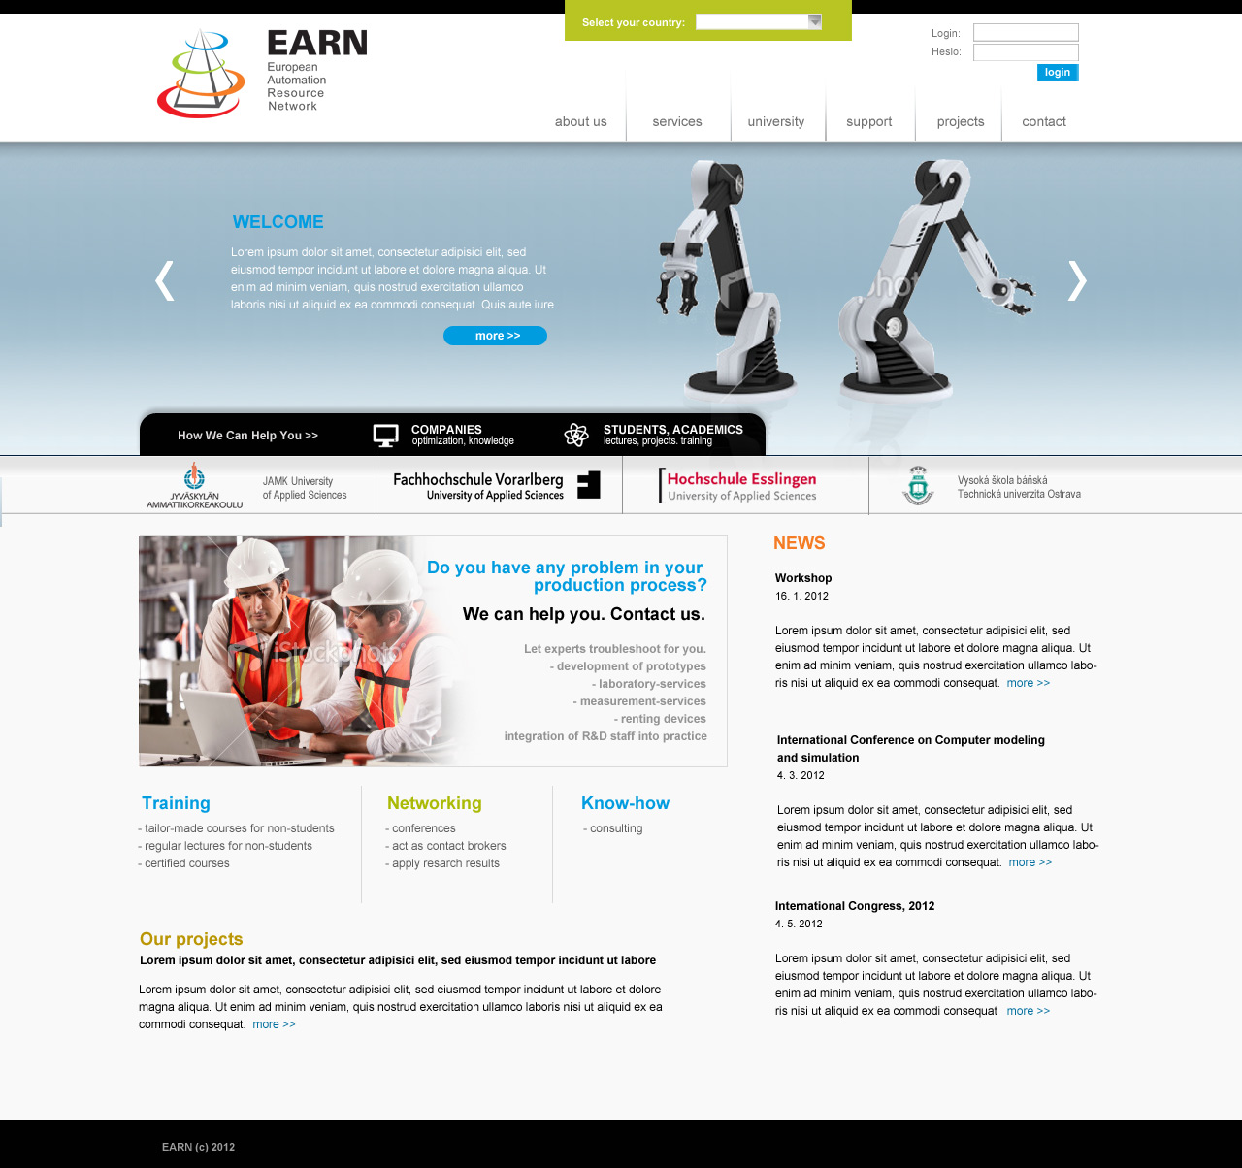
Mockup example – web site in Corel

Slide 35
Wireframe
Mainly used with a web application development
„visual representation of content layout in a website design“.
Location of elements

Slide 36
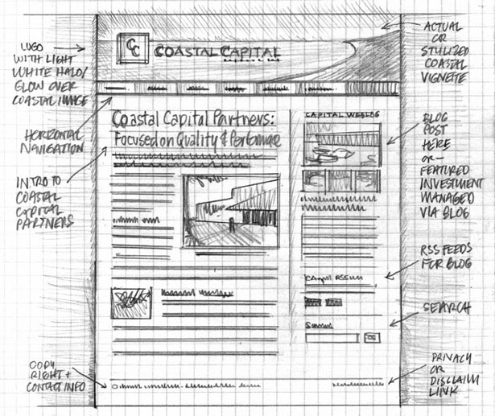
Wireframe

Slide 37
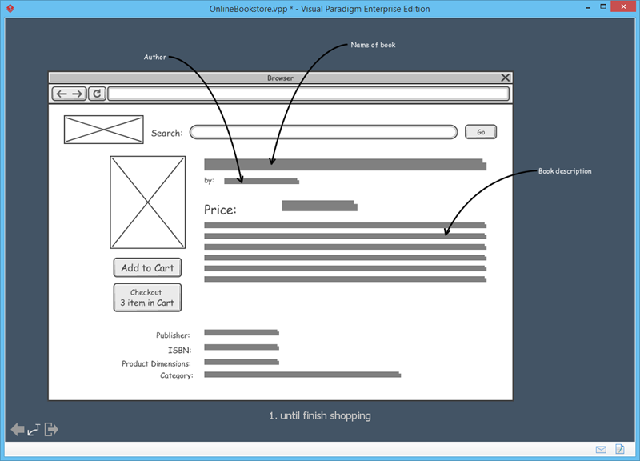
Visual Paradigm

Slide 38
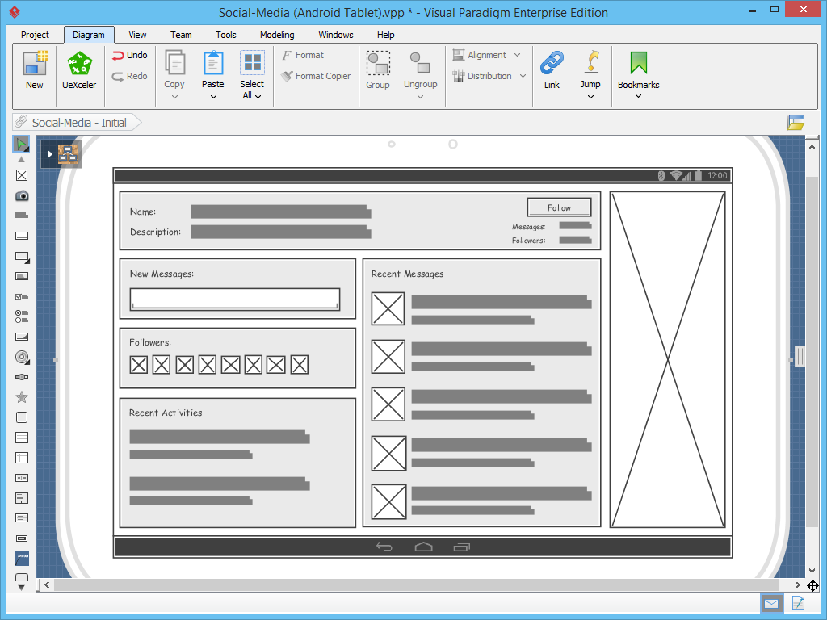

Slide 39
When?
BEFORE THE BEGINNING to show proof of concept to senior management
IN THE BEGINNING to gather initial user requirements
AFTER THE BEGINNING to validate evolving user requirements
IN THE MIDDLE STAGES to validate system specifications
IN MIDDLE AND LATER STAGES to pre-train users or to create a marketing demo
IN THE LATER STAGES to explore solutions to specific usability or design problems

Slide 40
Prototype fidelity
Fidelity = accuracy of the prototype
Low-fidelity prototype – incomplete, it shows only a part, may be in the form of an image
High-fidelity prototype – prototype is close to the finished product

Slide 41
Horizontal and vertical prototype
Horizontal – focus on it to show all the functionality and context
Vertical – Only part of the system with an emphasis directed the prototype to final product

